Slide 1
Unit 7: Memory Organization
Reference : Chapter 12 Computer System Architecture by Morris Mano

Slide 2
Memory Hierarchy
What is Memory?
Why different types of memory? (Main Memory, Auxiliary Memory)
    Volatile, Large Storage, Speed
Main Memory: memory unit that communicates directly with the CPU
  RAM, ROM
Auxiliary Memory: provide backup storage
  Magnetic disk

Slide 3
Memory Organization and Relation
Magnetic
Disk
I/O Processor
Magnetic Tapes
Main Memory
CPU
Cache Memory

Slide 4
Memory Hierarchy
Smaller
Faster
Costlier
(per byte storage)
Registers
Cache
(SRAM)
Main memory
(DRAM)
Larger
Slower
Cheaper
(per byte storage)
Local secondary storage
(local disks)
Remote secondary storage
(tapes, distribute file systems, web servers)

Slide 5
Multiprogramming
Concept used in OS which enable the CPU to Process a number of independent programs concurrently.
Keep CPU busy by working with several programs in sequence.

Slide 6
Main Memory
Relatively large and fast memory used to store programs and data during the computer operation.
RAM(Random Access Memory)
  Static and Dynamic
ROM(Read Only Memory)

Slide 7
RAM (Random Access Memory)
Volatile
Can perform Read and Write operation
SRAM (Static RAM)
  consist of internal flip-flops that store the binary information.
    Cache Memory
DRAM(Dynamic RAM)
  Stores the Binary information in the form of electric charges that are applied to capacitors
  Refreshing is required
  Reduced power consumption and Larger storage capacity

Slide 8
ROM (Read Only Memory)
Non volatile
Can perform Read operation only
Store programs and data that are permanently reside in the computer that do not change in value.
  Store Bootstrap Loader

Slide 9
Bootstrap Loader
It is a program whose function is to start the computer software operating when power is turned on.
When power is turned on, the hardware of the computer sets the program counter to the first address of the bootstrap loader.
The bootstrap program loads a portion of the operating system from disk to main memory and control is then transferred to the OS, which prepares the computer for general use.

Slide 10
RAM Chip
Block Diagram
Chip Select 1
128 × 8
RAM
CS1
Chip Select 2
CS2
Read
RD
8-bit Data Bus
Write
WR
7-bit Address
AD7
Function Table
CS1 | CS2 | RD | WR | Memory Function | State of the Data Bus
0
0
×
×
Inhibit
High Impedance
0
1
×
×
Inhibit
High Impedance
1
1
×
×
Inhibit
High Impedance
1
0
0
0
Inhibit
High Impedance
1
0
0
1
Write
Input data to RAM
1
0
1
×
Read
Output data from RAM

Slide 11
ROM Chip
Block Diagram
Chip Select 1
512 × 8
ROM
CS1
Chip Select 2
CS2
8-bit Data Bus
9-bit Address
AD9

Slide 12
Memory Connection to the CPU
Require Memory: 512 Bytes of RAM and 512 Bytes of ROM
Available chip
  RAM: 128 × 8
  ROM: 512 × 8
No of RAM and ROM Chip required
  4 RAM Chip
  1 ROM Chip

Slide 13
CPU
Data bus
128 × 8
RAM 1
128 × 8
RAM 2
128 × 8
RAM 3
128 × 8
RAM 4
512 × 8
ROM
CS1
8 bit data
CS2
RD
WR
AD7
CS1
CS2
RD
WR
AD7
CS1
CS2
RD
WR
AD7
CS1
CS2
RD
WR
AD7
CS1
CS2
AD9
WR
1
RD
1-7
8
9
1-7
0
8
Decoder
1
Address bus
2
9
3
10
11-16
Address :
0 0 0 0 0 0 0 0 1 1 0 0 1 0 1 0
0
0
1
1 0 0 1 0 1 0

Slide 14
Memory Address Map
Note: Bits 11 to 16 are all zero
Component | Starting Address |  |  |  |  |  |  |  |  |  |  | Ending Address
 | Binary |  |  |  |  |  |  |  |  |  | Hexa Decimal | Binary |  |  |  |  |  |  |  |  |  | Hexa Decimal
 | 10 | 9 | 8 | 7 | 6 | 5 | 4 | 3 | 2 | 1 |  | 10 | 9 | 8 | 7 | 6 | 5 | 4 | 3 | 2 | 1
RAM-1
RAM-2
RAM-3
RAM-4
ROM
0
0
0
0
0
0
0
0
0
0
0000
0
0
0
1
1
1
1
1
1
1
007F
0
0
1
0
0
0
0
0
0
0
0080
0
0
1
1
1
1
1
1
1
1
00FF
0
1
0
0
0
0
0
0
0
0
0100
0
1
0
1
1
1
1
1
1
1
017F
0
1
1
0
0
0
0
0
0
0
0180
0
1
1
1
1
1
1
1
1
1
01FF
1
0
0
0
0
0
0
0
0
0
0200
1
1
1
1
1
1
1
1
1
1
03FF

Slide 15
Associative Memory
A memory unit accessed by content is called an associative memory or content addressable memory(CAM).
Time required to find an item stored in memory can be reduced.
Can be accessed simultaneously.
The memory is capable of finding an empty unused location to store the word.
When a word is to be read from the memory, the content of the word, or part of the word, is specified.
The memory locates all words which match the specified content and marks them for reading.
Expensive

Slide 16
Cache Memory
Locality of reference: few localized areas of memory are repeatedly referred.
If the active program and data are placed in a fast small memory, the average memory access time can be reduced, thus reducing total execution time of the program. Such a fast small memory is referred to as a cache memory.
Less access time than main memory.
What happens when CPU access memory?
  CPU-----> Cache Memory ----->Main Memory

Slide 17
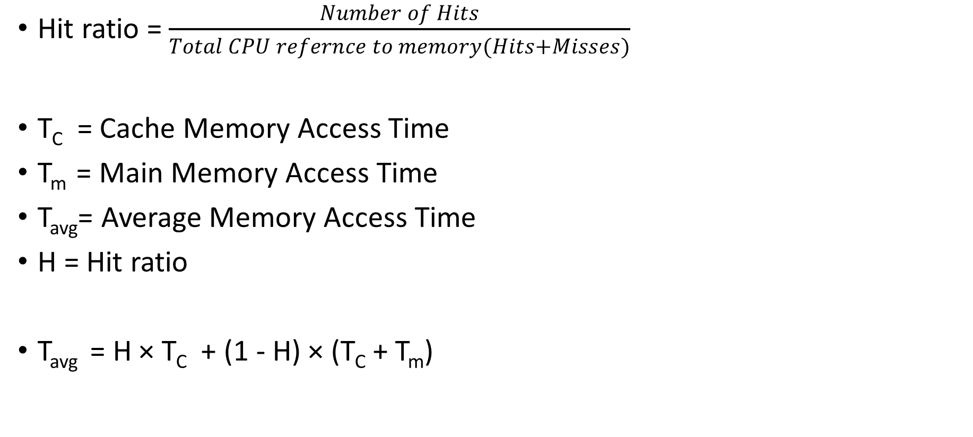
Performance of Cache Memory
Hit ratio = $\frac{Number of Hits}{Total CPU refernce to memory(Hits+Misses)}$
T_{C} = Cache Memory Access Time
T_{m} = Main Memory Access Time
T_{avg}= Average Memory Access Time
H = Hit ratio
T_{avg} = H × T_{C} + (1 - H) × (T_{C} + T_{m})

Slide 18
Addressing Mapping
Decide which block of main memory has to be placed where in the cache memory.
Three types of Mapping process:
  Direct Mapping
  Associative Mapping
  Set – Associative Mapping

Slide 19
Direct Mapping
K^{th} Block of main memory is placed in (K^{th} mod N)^{th} block of cache memory.
32 words in Main Memory
16 words in Cache Memory
Block size= 4 words
Physical Address= 5 bits
0
0 mod 4 = 0
1
2
2 mod 4 = 2
0
3
Tag
1
4
4 mod 4 = 0
2
3
5
1 Bit of Tag is required
Cache Memory
No of Block(N)=4
0
1
6
7
MM Blocks That Can be Placed in Block 0 of CM are {0,4}
Main Memory
No of Block(M)=8
MM Blocks That Can be Placed in Block 1 of CM are {1,5}
MM Blocks That Can be Placed in Block 2 of CM are {2,6}
MM Blocks That Can be Placed in Block 3 of CM are {3,7}

Slide 20
Direct Mapping
1 bit
2 bits
2 bits
Physical address
TAG
Cache Block Offset
Word Offset
0
1
0
0
1
0
0 mod 4 = 0
Compare
1
1
2
2 mod 4 = 2
0
0
3
Tag
1
0
4
4 mod 4 = 0
2
1
3
5
Tag bits are same.
So word is present.
It is at location 1.
Cache Memory
No of Block(N)=4
6
7
7 mod 4 = 3
Check word no 9 is present in cache or not?
Main Memory
No of Block(M)=8
Physical Address
0
1
0
0
1

Slide 21
Example
MM= 512 words
CM = 64 words
Block size= 16 words
How many Bits for Physical Address?
How many TAG Bits are required?
How many Bits are required for cache offset?
How many Bits are required for word offset?
If MM blocks 16, 9, 26, 7 are present in CM than show Tag of each cache.
Now Check on above cache representation that word 237 and 400 is Present? and How?

Slide 22
Direct Mapping
3 bit
2 bits
4 bits
Physical address
PA= 9 Bits
TAG
Cache Block Offset
Word Offset
0
1
10000
16
100
2
00
16
01001
9
3
010
9
Tag
01
11010
26
4
110
26
10
00111
7
001
:
11
7
Cache Memory
No of Block(N)=4
30
31
Check word is present in cache or not?
word no 237
word no 400
word no 145
PA:
010
01
0001
Main Memory
No of Block(M)=32
PA:
011
10
1101
PA:
110
01
0000
TAG is Different in 10
TAG is Different in 01
TAG is same in 01
word is at 0001 in that block
© Ronak Patel, Computer Engineering Department , CSPIT, CHARUSAT

Slide 23
Limitation of Direct Mapping
  Conflict penalties:
    Present of one block abstracting the incoming block inspite of the cache is free
    MM Block ref: 0, 4, 0, 4, 8, 0, 4, 12, 4, 12

Slide 24
Associative Mapping
Any Block of main memory can be placed any where in the cache
Physical address
TAG
Word Offset
3 bits
2 bits
0
1
000
0
2
010
3
Tag
1
111
4
2
3
5
Cache Memory
No of Block(N)=4
6
7
Main Memory
No of Block(M)=8

Slide 25
Example
MM= 512 words
CM = 64 words
Block size= 16 words
How many Bits for Physical Address?
How many TAG Bits are required?
How many Bits are required for cache offset?
How many Bits are required for word offset?
If MM blocks 16, 9, 26, 7 are present in CM than show Tag of each cache.
Now Check on above cache representation that word 237 and 400 is Present? and How?

Slide 26
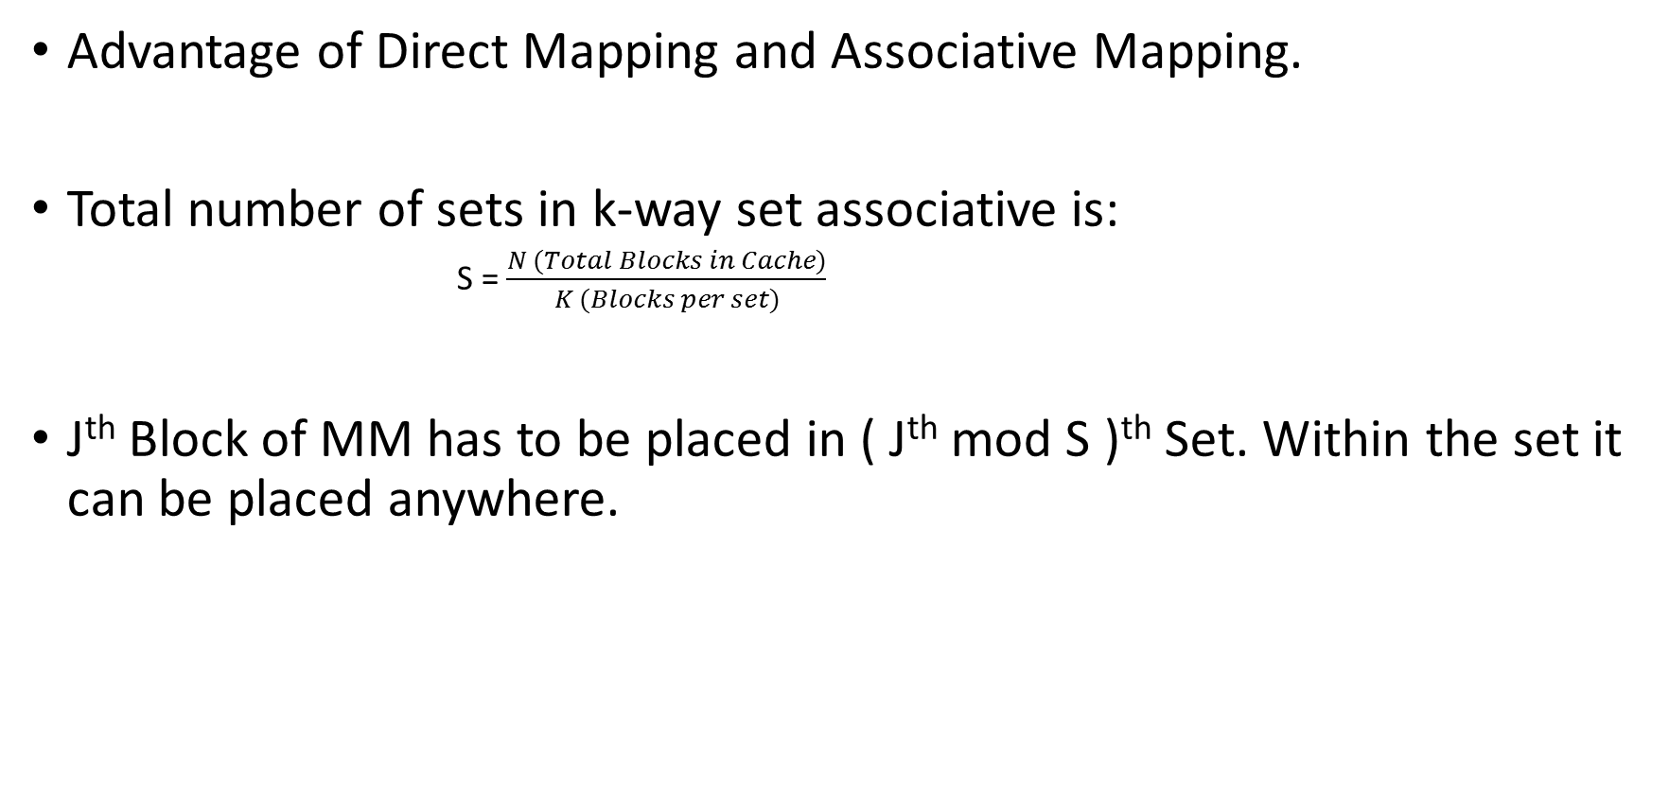
Set Associative Mapping
Advantage of Direct Mapping and Associative Mapping.
Total number of sets in k-way set associative is:
            S = $\frac{N (Total Blocks in Cache)}{K (Blocks per set)}$
J^{th} Block of MM has to be placed in ( J^{th} mod S )^{th} Set. Within the set it can be placed anywhere.

Slide 27
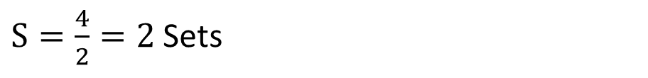
2 Way Set Associative Mapping
$S=\frac{4}{2}=2$ Sets
Physical address
TAG
Set Offset
Word Offset
0
0 mod 2 = 0
2 bits
1 bit
2 bits
1
00
2
2 mod 2 = 0
0
01
3
1
11
4
2
3
5
Cache Memory
No of Block(N)=4
6
7
7 mod 2 = 1
Main Memory
No of Block(M)=8

Slide 28
Example
MM= 512 words
CM = 64 words
Block size= 16 words
2-way Set Associative
How many Bits for Physical Address?
How many TAG Bits are required?
How many Bits are required for set offset?
How many Bits are required for word offset?
If MM blocks 16, 9, 26, 7 are present in CM than show Tag of each cache.
Now Check on above cache representation that word 237 and 400 is Present? and How?

Slide 29
Question
Consider 1MB cache and 4 GB MM are partitioned into 64KB blocks.
How many bits are required for Physical address if word size is 1B?
How many block are there in MM and CM?
How many TAG bits are required for
    Direct Mapping
    Associate Mapping
    8-Way set Associative Mapping
How many TAG memory in Bytes are required for each case?

Slide 30
Answer
32 bits
Physical address
TAG Comparator
TAG Memory
Direct Mapping:
TAG
CB Offset
Word Offset
1 – 12 bits
16 × 12 = 192 bits = 24 B
12 bits
4 bits
16 bits
Associative Mapping:
TAG
Word Offset
16 – 16 bits
16 × 16 = 256 bits = 32 B
16 bits
16 bits
8-Way Set Associative:
TAG
Set Offset
Word Offset
8 – 15 bits
16 × 15 = 240 bits = 30 B
15 bits
1 bit
16 bits

Slide 31
Observation
What about 1 way set associative?
  It is similar to direct mapping.
  Because each set contains 1 block. To select set we use modulo operation. So, It will tell you in which set you have to go and there is one block only in that, which is similar to direct mapping.
What about N-way set associative?
  It is similar to Associative Mapping.
  As set size is equal to total number of cache block, there is only 1 set.
  In set you can put your block any where which is similar to associative mapping.

Slide 32
Writing to main memory
Write-through
  Useful in Direct memory access transfer
Write-back
Cache Initialization
Valid bit

Slide 33
Virtual Memory
What is it?
Why it is required?
Paging overview

Slide 34
Any Questions
?

